Slide 1
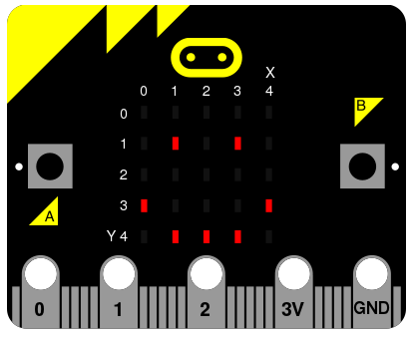

Making with the BBC micro:bit
https://aka.ms/ChickTechATX2017MicroBit

Slide 2
